Slide 1

Competitive Programming From Problem 2 Solution in O(1)
P
T
H
I
N
K
F
A
S
T
S
C++: Selection
Mostafa Saad Ibrahim
Teaching Assistant @ Cairo University

Slide 2
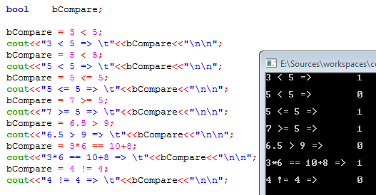
Relational Expression (condition)

Slide 3
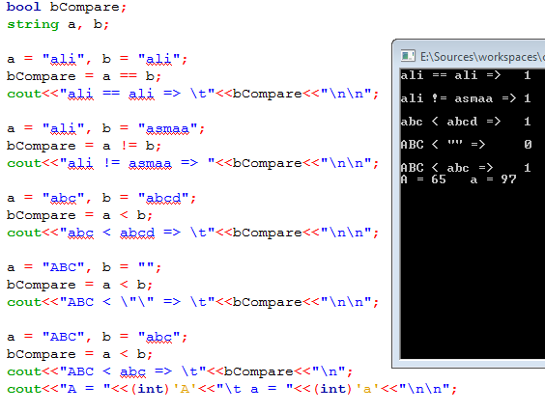
Relational Expression

Slide 4
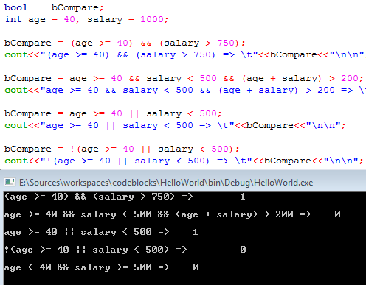
Logical Operators

Slide 5
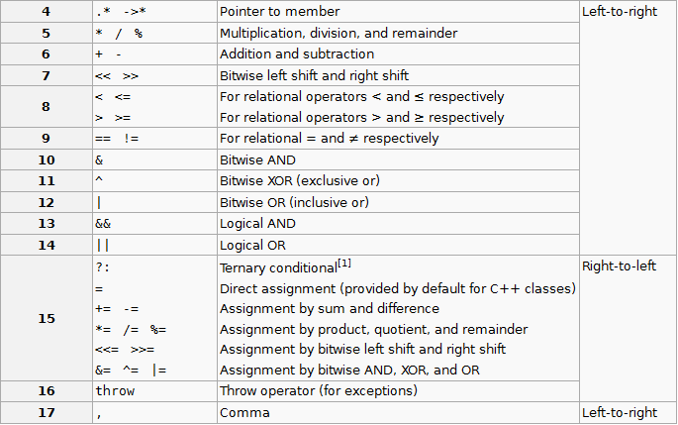
In more complex expressions...

Slide 6
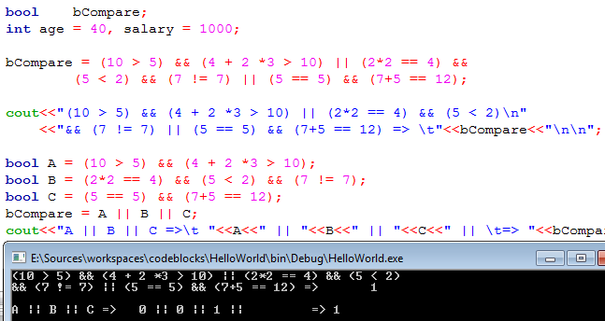
Logical Operators

Slide 7
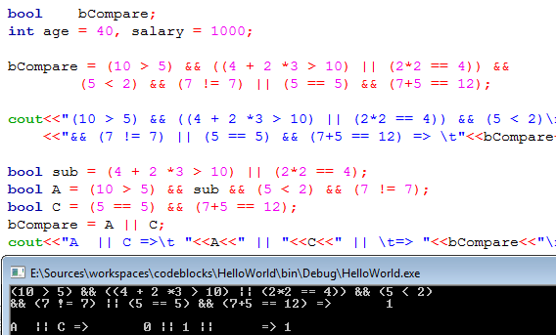
Logical Operators

Slide 8
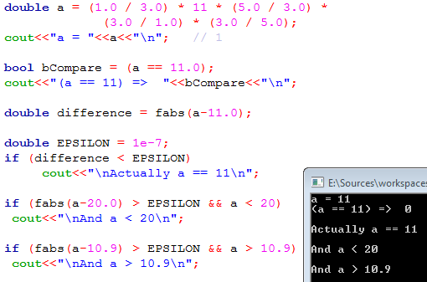
Percision Numbers Comparison

Slide 9
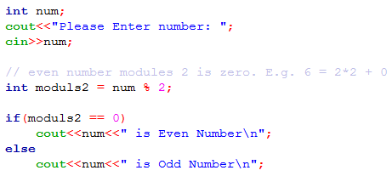


The if-else Statement

Slide 10
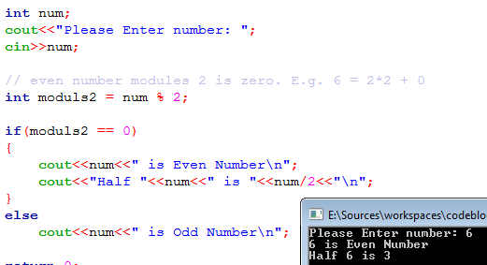
The Compound if-else Statement

Slide 11
Remember the scope
Braces {} represents a scope
Any variables defined inside it can NOT be used outside the scope {}

Slide 12
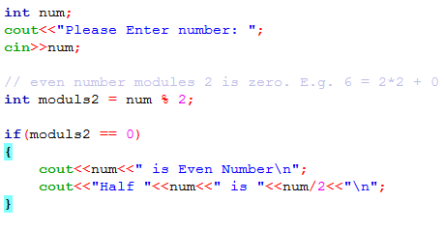
One-Way Selection (no else)

Slide 13
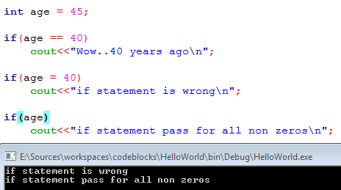
Be Careful

Slide 14
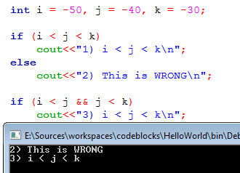
Be Careful

Slide 15
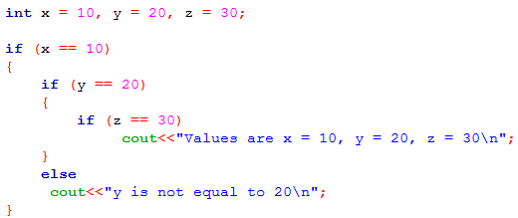
Nested if Statements

Slide 16
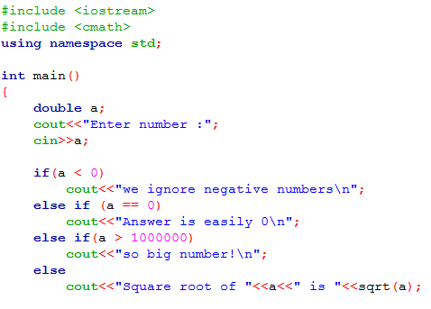
The if-else Chain

Slide 17
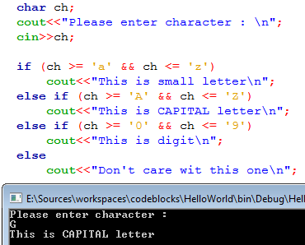
The if-else Chain

Slide 18
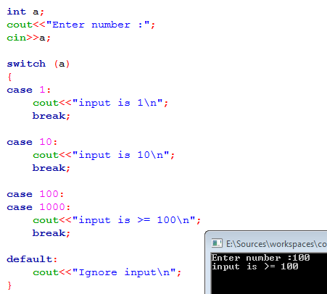
The switch Statement

